Slide 1

Metabarcoding Data Programme
Notes:
Text from postcard:
Pilot initiative will strengthen links between the GBIF network and DNA metabarcoding data communities while building node capacity for standardizing the publication of biodiversity data through the Metabarcoding Data Toolkit (MDT)

Slide 2
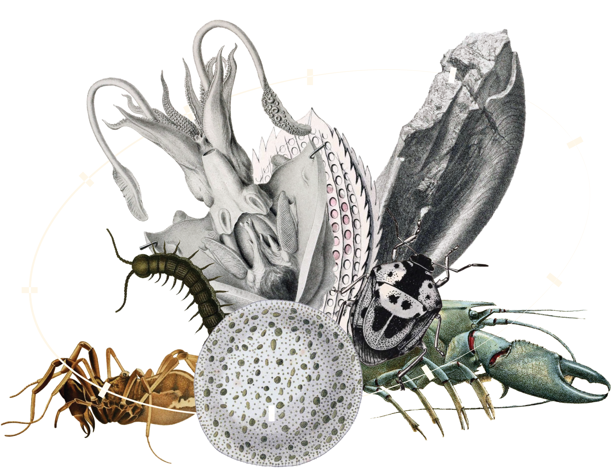
Metabarcoding data programme
Pilot initiative to strengthen links between the GBIF network and DNA metabarcoding data communities while building node capacity for standardizing the publication of biodiversity data through the Metabarcoding Data Toolkit
Notes:
Notes

Slide 3

Try out the demo version
Publishing mode: In this mode, users can register datasets with GBIF on behalf of their organizations. The Metabarcoding Data Toolkit functions like an IPT, operating as a platform for publishing hosted datasets directly by GBIF.
Conversion-only mode: In this mode, users can prepare their datasets using the MDT but the processed datasets/archive must be download and published through other channels, such as a GBIF IPT installation. This mode is suitable for scenarios where data holders are undecided whether to have GBIF host their datasets or not.
Check out the metabarcoding data toolkit

Slide 4
Metabarcoding data programme
In its ongoing efforts to enrich the GBIF data model and accommodate a broader range of biodiversity data, the GBIF Secretariat has launched a new programme aimed at improving the integration of DNA metabarcoding data. GBIF nodes that participate in the initiative's pilot phase will manage instances of a newly developed tool—the Metabarcoding Data Toolkit (MDT)—enabling them to engage researchers and communities around the world who hold metabarcoding data on biodiversity.
Node managers are invited to apply to signal their interest in managing an installation of the MDT. Input from GBIF nodes and testing on multiple eDNA datasets has shaped the tool, which provides a standardized approach for formatting and publishing metabarcoding data.
The objective of this programme is to empower GBIF nodes to support and mobilize DNA metabarcoding data within their own networks. Programme activities will include not only testing and refining the MDT to meet the needs of both nodes and users, but also providing nodes with training to administer the tool, refining and translating guidance materials, and aligning workflows for metabarcoding data with the GBIF network's structures and practices.

Slide 5

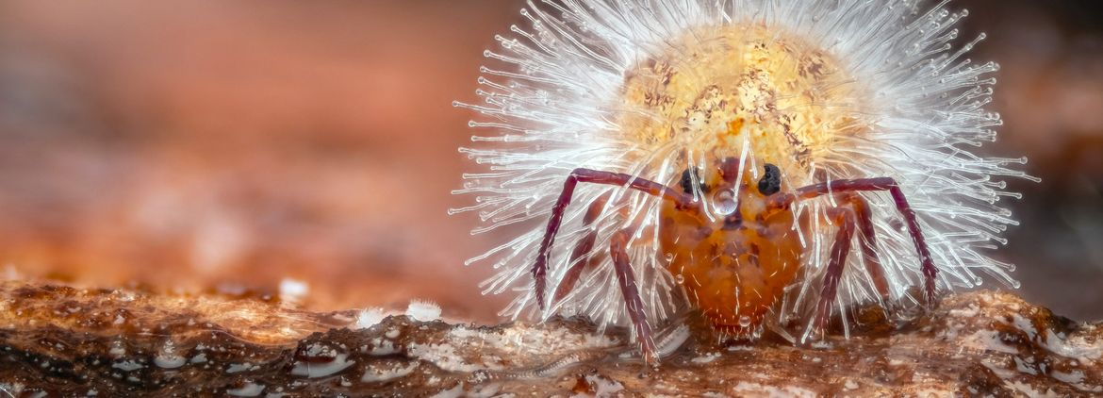

Featured publishers of soil-related data
GBIF nodes invited to join pilot for DNA metabarcoding data on biodiversity
GBIF briefing on Digital Sequence Information (DSI)
Metabarcoding Data Toolkit – user guide
Notes:
Notes

Slide 6

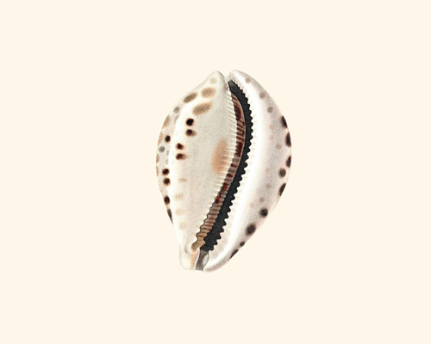


Featured metabarcoding datasets
Eukaryotes detected in marine water (collected July 2023) from the North Atlantic by the MSC Poesia cruise ship; inferred from 18S DNA metabarcoding data.
eDNA from water column to characterise fish and invertebrate communities from 30 sites in the Belgian Part of the North Sea -COI
COI data from: Environmental DNA metabarcoding differentiates between micro-habitats within the rocky intertidal (Shea & Boehm, 2024)
Comparison of Environmental DNA and SCUBA Diving Methods to Survey Keystone Rockfish Species on the Central Coast of British Columbia, Canada
Notes:
Notes

Slide 7
Metabarcoding data programme
Learn more!

